Slide 1
USABILITY ENGINEERING

Slide 2
USABILITY ENGINEERING
Definition
UI Generations
Evaluation
Lifecycle
Classification of Users
Prototyping
Usability Testing Stages.

Slide 3
USABILITY ENGINEERING
Usability is the Effectiveness, Efficiency and Satisfaction with which specified users can achieve specified goals in particular environments.
Effectiveness is the accuracy and completeness with which users achieve specific goals.
Efficiency is the accuracy and completeness of goals achieved in relation to resources expended.
Satisfaction is the comfort and acceptability of using the system.

Slide 4
USABILITY
Usability – one of the key concepts in HCI – focus in on creating systems that are easy to learn and use.
Usability is Characterized by 5 E’s;
Easy to Learn
Easy to remember - how to use.
Effective to Use
Efficient to Use
Enjoyable to Use

Slide 5
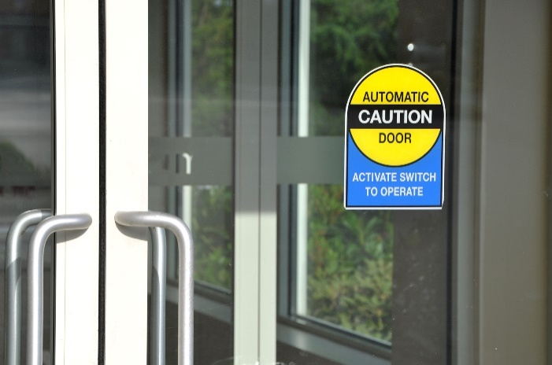
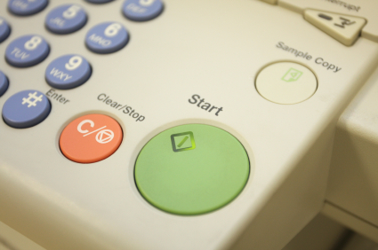
EXAMPLE
How many times have V come across glass doors with a handle that does not indicate the opening mode !
Push AND Pull Stickers are not SIGNS of a GOOD Design!
Design of the Handle should indicate the affordance!
Photocopiers – XEROX machines
Two buttons with and C
C is treated by modern day users as COPY !
But in the Photocopier, the copier operation and C is for Cancel
Not to entirely blame given the C for Cancel model from Calculators usage!!

Slide 6
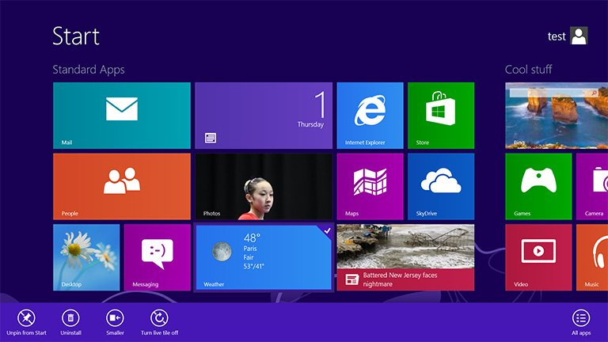
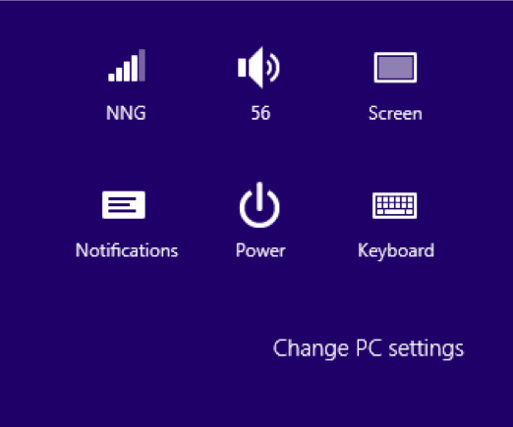
NIELSEN’S SUMMARY OF WINDOWS 8
Jacob Nielsen – Father of Usability Engineering & Nielsen Norman Group (nng) – their famous organization
Nielsen’s Summary of Windows 8
Hidden features,
Shutdown was a real treasure hunt!
Reduced discoverability,
Reduced power from a single-window UI
Smothers usability with big colorful tiles while hiding needed features.
New design optimized for touchscreen

Slide 7
GENERATIONS OF USER INTERFACES
In the field of human-computer interaction, a user interface (UI) is that the space where interactions between humans and machines occur.
The goal of this interaction is to permit effective operation and control of the machine from the human end, whilst the machine simultaneously feeds back information that aids the operators’ decision-making process

Slide 8
GENERATIONS OF USER INTERFACES
Batch System
Line-oriented interface
Full screen interface
Graphical user interface
Future of the User interfaces
Augmented Reality
Virtual Reality
Holographic User Interfaces
Brain-Computer interfaces

Slide 9
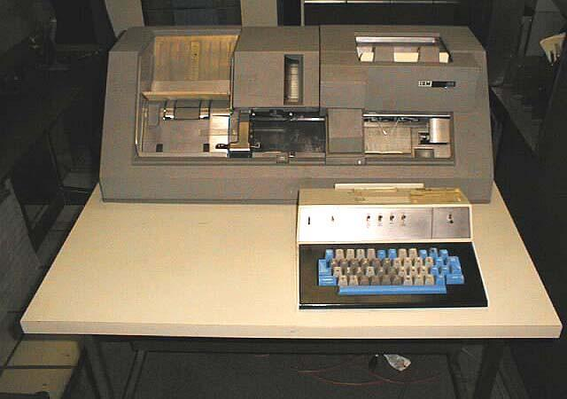
BATCH SYSTEM
During the batch era, computing power was extremely scarce and expensive.
The input side of the user interfaces for batch machines was mainly punched cards or equivalent media.
The output side added line printers to those media.
Early batch systems gave the currently running job the whole computer; program decks and tapes had to incorporate what we might now consider as OS code to speak to I/O devices

Slide 10
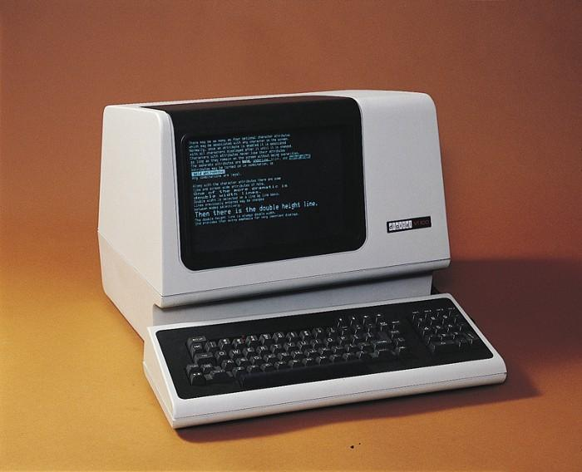
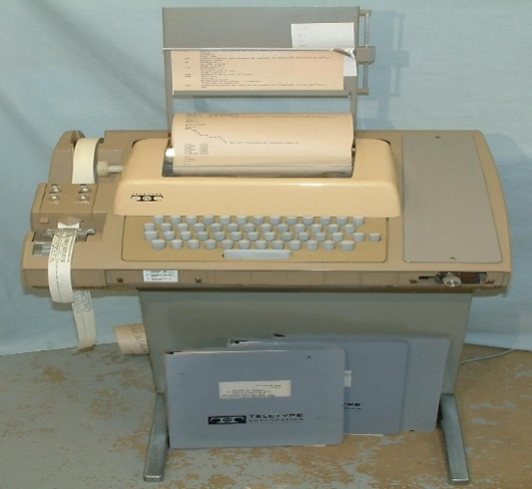
LINE-ORIENTED INTERFACE
A user interface based on a user editing individual lines of text at a time, especially with regard to early text editors.
instead of moving around in the document as in screen-oriented editors or graphical user interfaces, the user could enter commands to list out lines within a document or could specify a line to edit.
The user could edit an individual line by inserting and removing characters and moving the cursor left and right.

Slide 11
FULL SCREEN INTERFACE
With the evolution of the User interfaces, entire screen began to use for the use.
A typical application of the full screen used as form filling dialogues.
The full-screen interfaces also lead to the invention many items that we use today such as menus, forms, applications etc.
Many full-screen interfaces also use function keys as a primary interaction style.

Slide 12
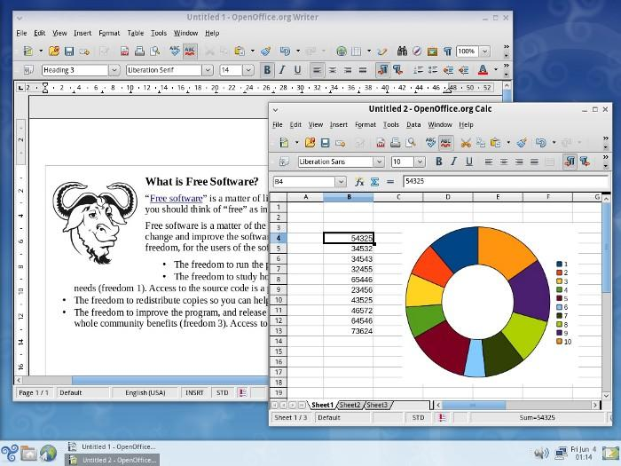
GRAPHICAL USER INTERFACE
1987 was a significant year in the evolution of UI. when the 386, the first true 32-bit Intel chip, became generally available and opened the possibility of Unix machines built with cheap commodity hardware.
Direct manipulation can be mentioned as the main interaction method found in many GUI
Many graphical user interfaces are object-oriented.
The first commercially available GUI, called “PARC,” was developed by Xerox.

Slide 13
FUTURE OF THE USER INTERFACES
Today we live surrounded by software products to a much greater extent than surrounded by people.
Over the past two decades with the effort of designers and developers, interfaces of software products have become more user-friendly, so the users have learned their basic language and now can use the same app on different devices.
Still software programs are created for the majority of users not considering the of each one of them individually, still, a new application means new language and a new device means a new pattern which has to be studied continuously.

Slide 14
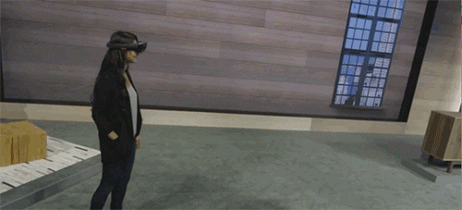
AUGMENTED REALITY
Augmented reality consists of overlaying data about the real world over real-time images of that world.
In current applications, a camera (generally attached to either a computer or cell phone) captures real-time images that are then superimposed with information gathered based on your location.
Example:
Google translate, and games such as Pokemon Go and Lenskart.

Slide 15
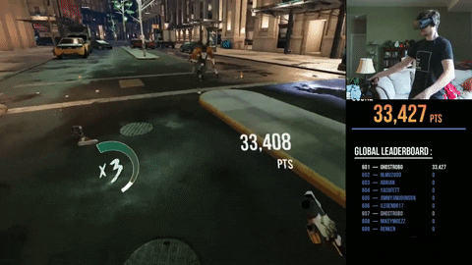
VIRTUAL REALITY
VR is a simulated experience that can be similar to or completely different from the real world.
Applications of virtual reality can include entertainment (eg: Gaming) and educational purposes (eg: Medical or Military training).
Currently, these systems use either VR headsets or multi-projected environments to generate realistic images, sounds and other sensations that simulate a user’s physical presence in a virtual environment.

Slide 16

HOLOGRAPHIC USER INTERFACES
A holographic display is a type of display that utilizes light diffraction to create a virtual three-dimensional image of an object.
Holograms are distinguished from other forms of 3D imaging in that they do not require the aid of any special glasses or external equipment for a viewer to see the image.

Slide 17
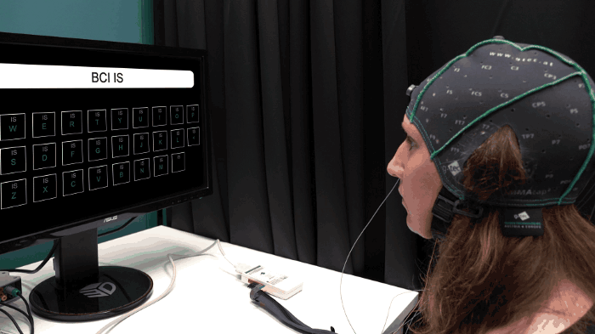
BRAIN-COMPUTER INTERFACES
Brain-computer interfaces could play a big role in the near future.
As the name implies, humans could soon be controlling computers using nothing but their brains.
It could allow people to easily control computers, mobile phones, and smart devices with a simple thought.

Slide 18
List the User Interface that you have come across
Categorize and order it based on the generations from Past to future
GUI
Command line interface,
Touchscreen
command prompt
Voice Based UI
Wearable User Interfaces
Augmented reality UI
Command line interface,
Command prompt
GUI
Touchscreen
Voice Based UI
Wearable User Interfaces
Augmented reality UI

Slide 19
THE CUSTOMERS USAGE CYCLE
Needs Assessment
Purchase
Installation
Introduction & Training
Limited Usage
Full usage
Evaluation (Next stage of development)
Evaluation (Reaches limitation of product)

Slide 20
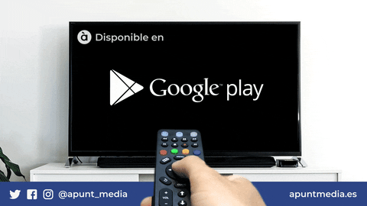
THE CUSTOMERS USAGE CYCLE
Needs Assessment
Purchase
Installation
Introduction & Training
Limited Usage
Full usage
Evaluation (Reaches limitation of product)
Evaluation (Next stage of development)

Slide 21
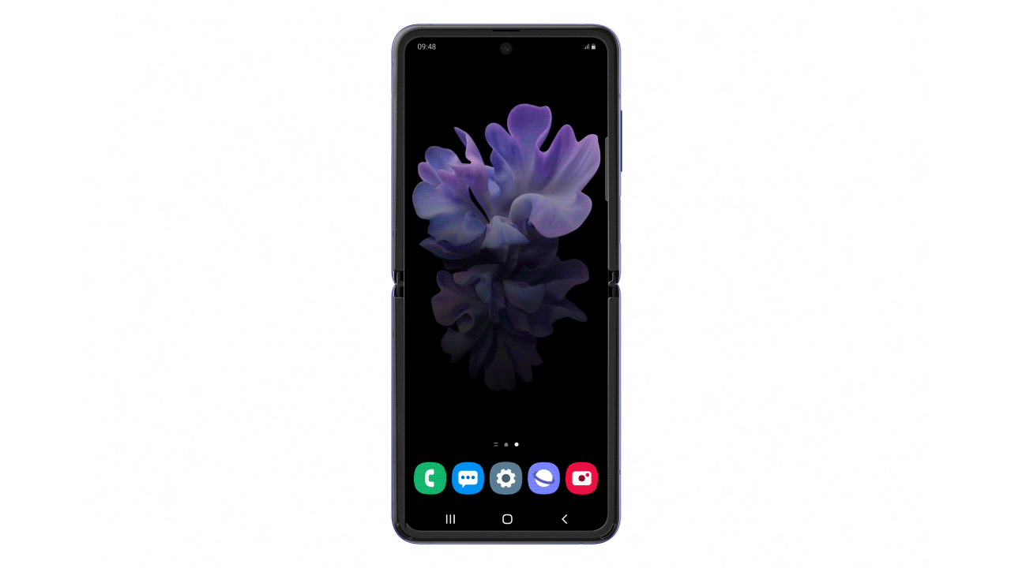
THE CUSTOMERS USAGE CYCLE
Needs Assessment
Purchase
Installation
Introduction & Training
Limited Usage
Full usage
Evaluation (Next stage of development)
Evaluation (Reaches limitation of product)

Slide 22
COST OF POOR USABILITY TO THE CUSTOMER AND THE SUPPLIER
Cost to Customer
Cost to Supplier
System Y is purchased with features
A B C D E
Cost of producing features D & E which are not used
Usability problems
User/Customer perceived utility is reduced
Customer user only features A B C
Perception of quality decreases
Perception of value is reduced
Customer becomes dissatisfied
Customer switches supplier

Slide 23
DESIGN LIFE CYCLE & THE ROLE OF EVALUATION
Previous Evaluation
Requirements Analysis
Evaluation
Design
Evaluation
Implementation
Evaluation
Usage
Evaluation

Slide 24
USABILITY OBJECTIVE
Usability objective should be a part of the requirement.
Objective - 1:
System to Teach Class-5 Mathematics
Should be used by students of age 8, without manual
Should enable students to learn 80% of the unit 4 in 15 Minutes.
Objective – 2
An Bank teller system to answer customer enquiries
Teller will be given one week training course followed by one month job training.
After training the teller should able to deal with 85% of customer requirements in 3 minutes.

Slide 25
USABILITY OBJECTIVE (CONTD.,)
Inference:
Objective 1 may consider multimedia user interface with graphics & sound
Objective 2 will be dealing with speed and effectiveness.
So the software designer needs to be clear what the objective are before design begins.

Slide 26
STAGES IN USABILITY SPECIFICATION & EVALUATION
Stage:1 User & Task Analysis
Stage:2 Set Usability objectives and success criteria for critical tasks
Usability Specification
Stage:3 Write a usability statement and identify things to be measured
Design & build the system or prototype
Stage:4 Choose techniques for measuring usability
Stage:5 Plan the usability evaluation
Usability Evaluation
Stage:6 Carryout the evaluation
Modify the design according to the result

Slide 27
STAGE 1 :USER AND TASK ANALYSIS
Who are the users, their characteristics
What tasks they are undertaking
Under what circumstances they are undertaking the tasks

Slide 28
STAGE 1 :USER AND TASK ANALYSIS
Office Systems
Systems: Database systems, spread sheets , Word, Management information systems
Users: Discretionary and intermittent users
Environment : colleagues, local expert, manual, documentation

Slide 29
STAGE 1 :USER AND TASK ANALYSIS
Public information systems
Systems: ATM, automatic ticket machine, Public information DB, Home teleshopping
Users: novice, Discretionary, and intermittent users
Environment : local expert

Slide 30
STAGE 1 :USER AND TASK ANALYSIS
Knowledge based systems
Systems: Planning, diagnostic and advice giving systems
Users: Experts
Environment : other expert, on line help

Slide 31
STAGE 1 :USER AND TASK ANALYSIS
Complex real time systems
Systems: military aircraft, large plant processing and monitoring systems(nuclear and chemical power stations), missile and rocket guidance systems
Users: Experts
Environment :support unlikely to be available considerable training required.

Slide 32
STAGE 1 :USER AND TASK ANALYSIS
Computer Supported Cooperative Work (CSCW)
Systems: E-Mail, Electronic conferencing, Electronic meeting
Users: novice and discretionary users
Environment :online support, local expert

Slide 33
STAGE 2:SETTING USABILITY OBJECTIVES AND SUCCESS CRITERIA
85% users enjoy using the system
Users can recall 70% of system commands after two weeks of not using the system
Users can learn to use 75% of the system features within 15 minutes

Slide 34
USABILITY OBJECTIVES RELATED TO SPECIFIC TASKS
Competitive edge
Theater Booking System
Market requirements
Automatic Teller Machine
Tasks performed first
First task decide the factor for success
Tasks performed most frequently
Efficiency of the system

Slide 35
USABILITY OBJECTIVES ARE SET OF CRITICAL TASKS
Usage Cycle Tasks | Introduction & Training | Limited Usage | Full Usage
Task 3 | Effectiveness Satisfaction
Task 8 |  |  | Efficiency
Task 9 |  | Effectiveness

Slide 36
STAGE 3 : WRITING USABILITY STATEMENTS AND IDENTIFYING MEASURES
A usability statement should include
Title, purpose and brief description of the system
A description of the intended users and their characteristics(knowledge, skills, motivation)
A brief description of the shared tasks and their characteristics(frequency, Timing)
A brief description of the equipment to be used(h/w, s/w)
A description of the Environment(work place conditions, support environment)
A specification of the usability objectives for a particular context

Slide 37
STAGE 3 : WRITING USABILITY STATEMENTS AND IDENTIFYING MEASURES
Each usability objective must contain a statement of the thing to be measured
Number of keystrokes
Number of commands used
Number of user actions required to complete a task
Time taken to perform keystrokes, commands or tasks
Time taken to learn a set of commands
Number of commands remembered
Knowledge of system use
Attitudes and opinions
Availability of support materials
Errors: of understanding ,typographical
Time to recover from errors

Slide 38
STAGE 4 :CHOOSING TECHNIQUES FOR MEASURING USABILITY
Carrying out measurement of usability is not an easy task, there may be various problems.
Problems with user who take part
Problems with person carrying out the measurement
Problems with how the results of the measurement are interpreted

Slide 39
STAGE 4 :CHOOSING TECHNIQUES FOR MEASURING USABILITY
Group 1 Techniques
Require specialist psychological knowledge
Require an expert in UID
Group 2 Techniques
Designer can use but only with expert advice
Group 3 Techniques
Designer can use without expert advice

Slide 40
GROUP 1 TECHNIQUES
Analytical Evaluation
Expert Evaluation
Experimental Evaluation

Slide 41
GROUP 1 TECHNIQUES
Analytical Evaluation
Used early in the design lifecycle
Predict the user performance
Represented using semi formal specification lang which enables designers to analyse and predict expert performance
Advantages
Evaluated without developing prototype without user testing
Disadvantages
Users are experts
Costly and time consuming

Slide 42
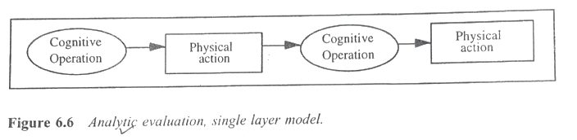
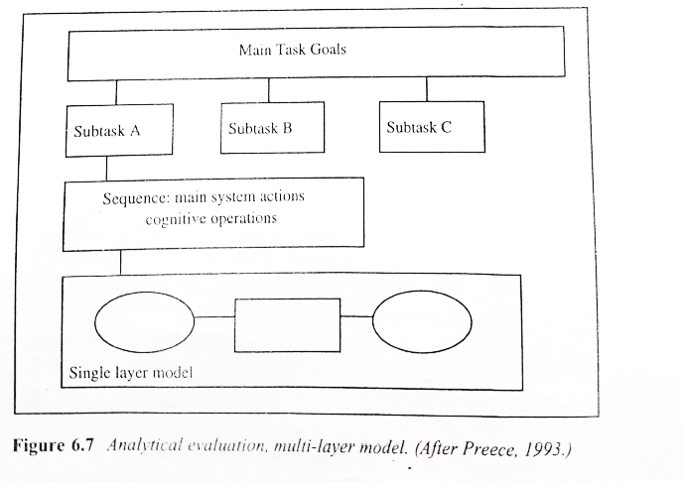
Analytical Evaluation – Single Layered Model
Analytical Evaluation – Multi Layered Model

Slide 43
GROUP 1 TECHNIQUES
Expert Evaluation
Experts use the design principles to evaluate the design , and would write up the results in a report
Experimental Evaluation
Experiments can be used
Experiments must be planned with the help of psychologist or human factors expert
Based on time, keystrokes etc statistical test is performed

Slide 44
GROUP 2 TECHNIQUES
Observation in a Usability laboratory
Observation in the work place
Interviews
Questionnaires
Focus groups

Slide 45
GROUP 2 TECHNIQUES
Observation in a Usability laboratory
In a usability lab or user’s normal place of work
Video camera and data logging
Observation in the work place
Without disturbing users make a log of user actions and user problems
Users are asked to say out loud what they are doing and this can be recorded

Slide 46
GROUP 2 TECHNIQUES
Interviews
Evaluator having fixed set of questions
Questionnaires
Evaluator should seek expert opinion in the design of a questionnaire
Focus groups
To allow a group of users to talk in a free form discussion with each other for 45 mins
4 to 6 users along with investigator(designer)
Audio recorder
Investigator should not take part in the discussion but should facilitate free discussion
How did they get started with the first task?
What difficulties did they have?

Slide 47
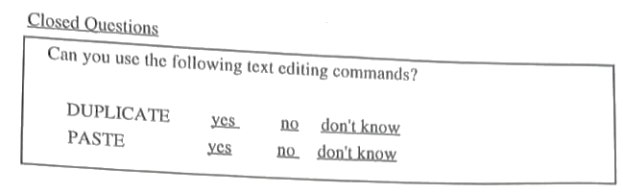
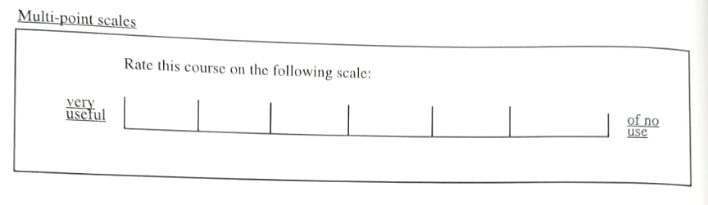
GROUP 2 TECHNIQUES

Slide 48
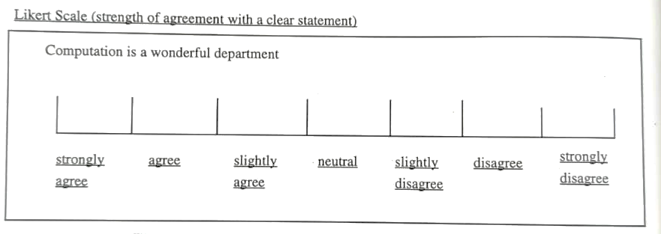
GROUP 2 TECHNIQUES

Slide 49
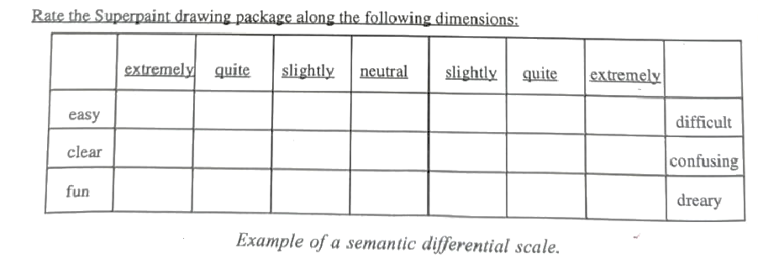
GROUP 2 TECHNIQUES

Slide 50
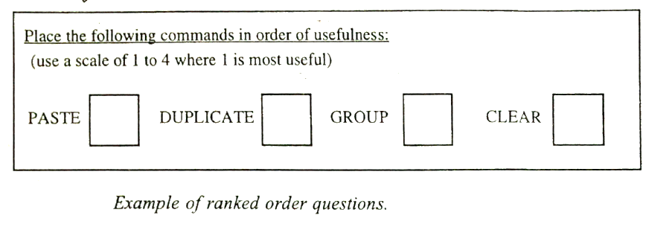
GROUP 2 TECHNIQUES

Slide 51
GROUP 3 TECHNIQUES
Feature checklists
Co operative Evaluation
Incident Diaries

Slide 52
GROUP 3 TECHNIQUES
Feature checklists
Which features available on the system are used by the users
To find out the features which are not used
Co operative Evaluation
Developed at York University, UK
Small handbook prepared for designers
Procedure for obtaining data about problems experienced by users when working with a prototype
Users and designers evaluate the sys together
Hand book contains step by step guide of how to prepare tasks for users ,how to interact with them ,recording etc

Slide 53
GROUP 3 TECHNIQUES
Incident Diaries
To provide the user with a means of recording incidents
Structured forms(Series of questions)
The form contains series of question
Eg 1. At what time did the problem occur?
2. What started the problem?
(i) did not know how to carry on?
(ii) unhelpful error msg
(iii) other, Please state

Slide 54
GROUP 3 TECHNIQUES
3. Which help facilities did you try?
(i) on screen help;
(ii) manual
(iiii) asked another user
(iv) watched another user
(v) other, Please state
4. Did the information obtained resolve your problem?
(i) yes,Completely
(ii) yes,Partly
(iii) No
5. How long did you spend trying to resolve the problem?
(i) less than a minute
(ii) Between 1 and 5 minutes
(iii) other , please state

Slide 55
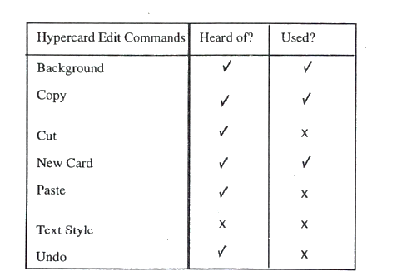
GROUP 3 TECHNIQUES
A Simple feature checklist

Slide 56
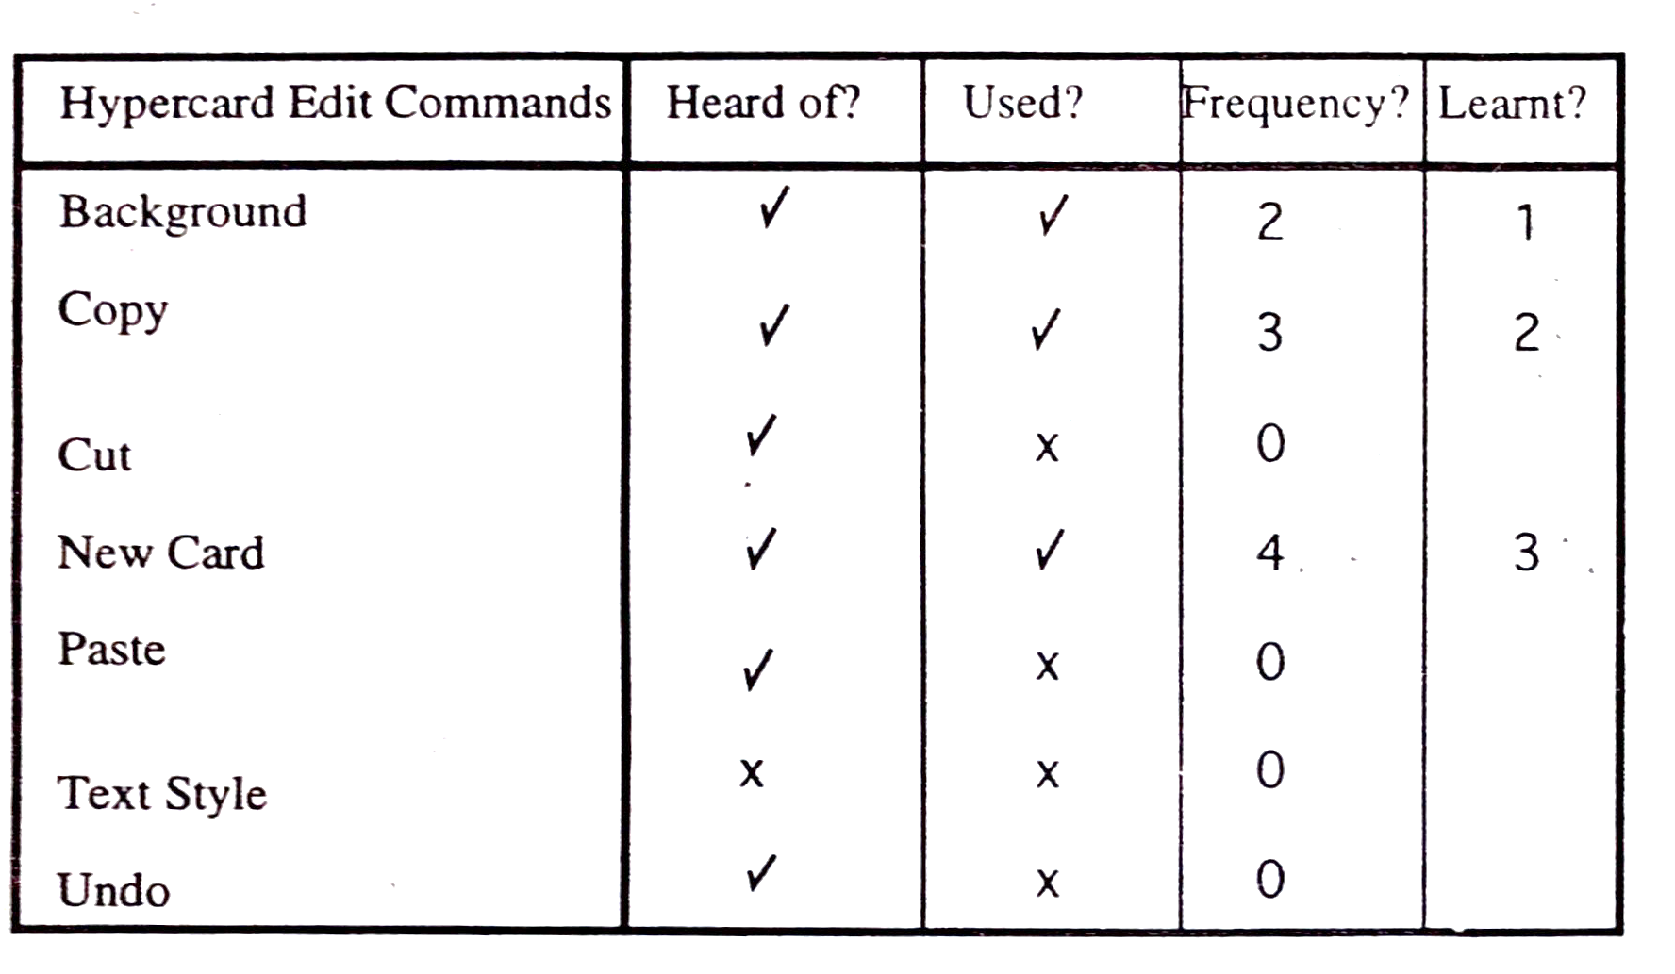
GROUP 3 TECHNIQUES
Expanded feature checklist

Slide 57
STAGE 5 : PLANNING A USABILITY EVALUATION
Usability evaluation will probably require the use of more than one evaluation technique.
Example 1 : Testing a CSCW prototype
Example 2 : Testing a system which is in use

Slide 58
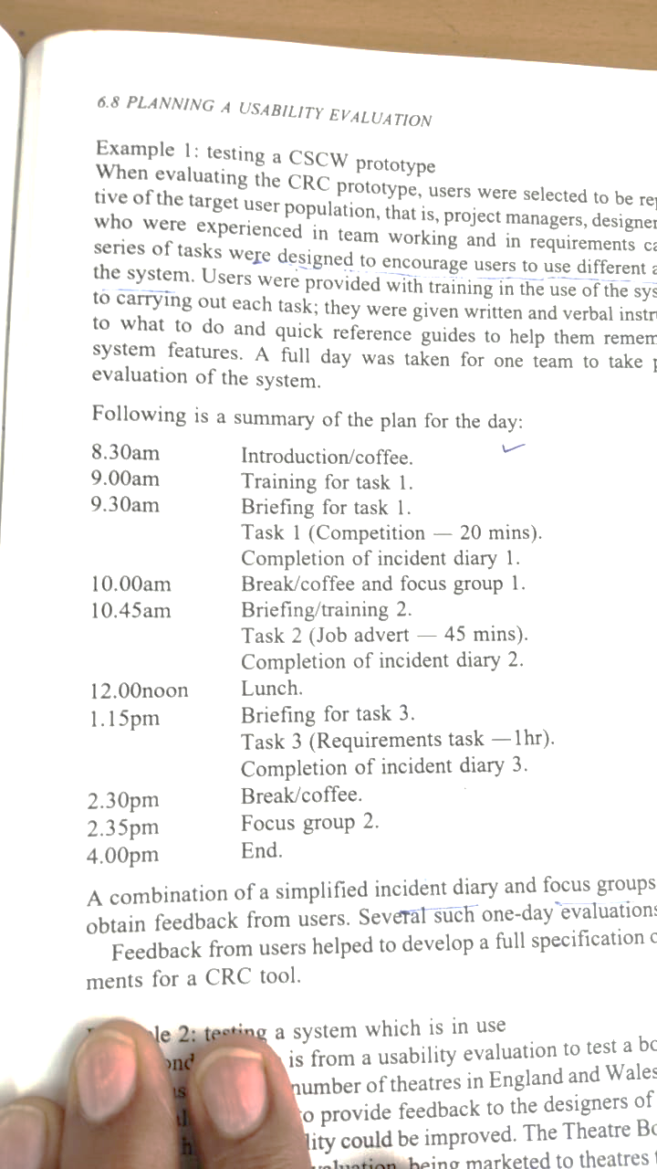
STAGE 5 : PLANNING A USABILITY EVALUATION
Example 1 :
Testing a CSCW prototype
A full day was taken by one team to take part in the evaluation system
A combination of incident diary and focus group are used to obtain feedback from users.

Slide 59
EVALUATION TECHNIQUES

Slide 60
EVALUATION TECHNIQUES
Evaluation
Tests usability and functionality of system
Occurs in laboratory, field and/or in collaboration with users
Evaluates both design and implementation
Should be considered at all stages in the design life cycle

Slide 61
GOALS OF EVALUATION
Assess extent of system functionality
Assess effect of interface on user
Identify specific problems

Slide 62
EVALUATING DESIGNS
Cognitive Walkthrough
Heuristic Evaluation
Review-based evaluation

Slide 63
EVALUATING DESIGNS: COGNITIVE WALKTHROUGH
Proposed by Polson et al.
Evaluates design on how well it supports user in learning task
Usually performed by expert in cognitive psychology
Expert ‘walks though’ design to identify potential problems using psychological principles
Forms used to guide analysis

Slide 64
EVALUATING DESIGNS: COGNITIVE WALKTHROUGH (CTD)
For each task walkthrough considers
what impact will interaction have on user?
what cognitive processes are required?
what learning problems may occur?
Analysis focuses on goals and knowledge: does the design lead the user to generate the correct goals?

Slide 65
EVALUATING DESIGNS: HEURISTIC EVALUATION
Proposed by nielsen and molich.
Usability criteria (heuristics) are identified
Design examined by experts to see if these are violated
Example heuristics
System behaviour is predictable
System behaviour is consistent
Feedback is provided
Heuristic evaluation `debugs' design.

Slide 66
EVALUATING DESIGNS: REVIEW-BASED EVALUATION
Results from the literature used to support or refute parts of design.
Care needed to ensure results are transferable to new design.
Model-based evaluation
Cognitive models used to filter design options
Design rationale can also provide useful evaluation information

Slide 67
EVALUATING THROUGH USER PARTICIPATION

Slide 68
LABORATORY STUDIES
Advantages:
specialist equipment available
uninterrupted environment
Disadvantages:
lack of context
difficult to observe several users cooperating
Appropriate
if system location is dangerous or impractical for constrained single user systems to allow controlled manipulation of use

Slide 69
FIELD STUDIES
Advantages:
natural environment
context retained (though observation may alter it)
longitudinal studies possible
Disadvantages:
distractions
noise
Appropriate
where context is crucial for longitudinal studies

Slide 70
EVALUATING IMPLEMENTATIONS
Requires an artefact:
Simulation, prototype,
Full implementation

Slide 71
EXPERIMENTAL EVALUATION
Controlled evaluation of specific aspects of interactive behaviour
Evaluator chooses hypothesis to be tested
A number of experimental conditions are considered which differ only in the value of some controlled variable.
Changes in behavioural measure are attributed to different conditions

Slide 72
EXPERIMENTAL FACTORS
Subjects
who – representative, sufficient sample
Variables
things to modify and measure
Hypothesis
what you’d like to show
Experimental design
how you are going to do it

Slide 73
EXPERIMENTAL FACTORS: VARIABLES
Independent variable (IV)
Characteristic changed to produce different conditions
E.G. Interface style, number of menu items
Dependent variable (dv)
Characteristics measured in the experiment
E.G. Time taken, number of errors.

Slide 74
EXPERIMENTAL FACTORS: HYPOTHESIS
Prediction of outcome
Framed in terms of IV and DV
E.G. “Error rate will increase as font size decreases”
Null hypothesis:
States no difference between conditions
Aim is to disprove this
E.G. Null hyp. = “No change with font size”

Slide 75
EXPERIMENTAL FACTORS: EXPERIMENTAL DESIGN
Within groups design
Each subject performs experiment under each condition.
Transfer of learning possible
Less costly and less likely to suffer from user variation.
Between groups design
Each subject performs under only one condition
No transfer of learning
more users required
Variation can bias results.

Slide 76
EXPERIMENTAL FACTORS: ANALYSIS OF DATA
Before you start to do any statistics:
look at data
save original data
Choice of statistical technique depends on
type of data
information required
Type of data
discrete - finite number of values
continuous - any value

Slide 77
ANALYSIS - TYPES OF TEST
Parametric
Assume normal distribution
Robust
Powerful
Non-parametric
Do not assume normal distribution
Less powerful
More reliable
Contingency table
Classify data by discrete attributes
Count number of data items in each group

Slide 78
ANALYSIS OF DATA (CONT.)
What information is required?
is there a difference?
how big is the difference?
how accurate is the estimate?
Parametric and non-parametric tests mainly address first of these

Slide 79
EXPERIMENTAL STUDIES ON GROUPS
More difficult than single-user experiments
Problems with:
Subject groups
Choice of task
Data gathering
Analysis

Slide 80
EXPERIMENTAL STUDIES ON GROUPS: SUBJECT GROUPS
Larger number of subjects ⇒ more expensive
Longer time to `settle down’ … even more variation!
Difficult to timetable
So … often only three or four groups

Slide 81
EXPERIMENTAL STUDIES ON GROUPS: THE TASK
Must encourage cooperation
Perhaps involve multiple channels
Options:
Creative task
Decision games
Control task

Slide 82
EXPERIMENTAL STUDIES ON GROUPS: DATA GATHERING
Several video cameras + direct logging of application
Problems:
Synchronisation
Sheer volume!
One solution:
Record from each perspective

Slide 83
EXPERIMENTAL STUDIES ON GROUPS: ANALYSIS
N.B. Vast variation between groups
Solutions:
Within groups experiments
Micro-analysis (e.G., Gaps in speech)
Subjective and qualitative analysis
Look at interactions between group and media
Controlled experiments may `waste' resources!

Slide 84
FIELD STUDIES
Experiments dominated by group formation
Field studies more realistic:
Distributed cognition ⇒ work studied in context
Real action is situated action
Physical and social environment both crucial
Contrast:
Psychology – controlled experiment
Sociology and anthropology – open study and rich data

Slide 85
OBSERVATIONAL METHODS
Think Aloud
Cooperative evaluation
Protocol analysis
Automated analysis
Post-task walkthroughs

Slide 86
OBSERVATIONAL METHODS: THINK ALOUD
User observed performing task
User asked to describe what he is doing and why, what he thinks is happening etc.
Advantages
Simplicity - requires little expertise
Can provide useful insight
Can show how system is actually use
Disadvantages
Subjective
Selective
Act of describing may alter task performance

Slide 87
OBSERVATIONAL METHODS: COOPERATIVE EVALUATION
Variation on think aloud
User collaborates in evaluation
Both user and evaluator can ask each other questions throughout
Additional advantages
Less constrained and easier to use
User is encouraged to criticize system
Clarification possible

Slide 88
OBSERVATIONAL METHODS: PROTOCOL ANALYSIS
Paper and pencil – cheap, limited to writing speed
Audio – good for think aloud, difficult to match with other protocols
Video – accurate and realistic, needs special equipment, obtrusive
Computer logging – automatic and unobtrusive, large amounts of data difficult to analyze
User notebooks – coarse and subjective, useful insights, good for longitudinal studies
Mixed use in practice.
Audio/video transcription difficult and requires skill.
Some automatic support tools available

Slide 89
OBSERVATIONAL METHODS: AUTOMATED ANALYSIS
Workplace project
Post task walkthrough
User reacts on action after the event
Used to fill in intention
Advantages
Analyst has time to focus on relevant incidents
Avoid excessive interruption of task
Disadvantages
Lack of freshness
May be post-hoc interpretation of events

Slide 90
OBSERVATIONAL METHODS: POST-TASK WALKTHROUGHS
Transcript played back to participant for comment
Immediately → fresh in mind
Delayed → evaluator has time to identify questions
Useful to identify reasons for actions and alternatives considered
Necessary in cases where think aloud is not possible

Slide 91
QUERY TECHNIQUES
Interviews
Questionnaires

Slide 92
QUERY TECHNIQUES: INTERVIEWS
Analyst questions user on one-to -one basis usually based on prepared questions
Informal, subjective and relatively cheap
Advantages
Can be varied to suit context
Issues can be explored more fully
Can elicit user views and identify unanticipated problems
Disadvantages
Very subjective
Time consuming

Slide 93
QUERY TECHNIQUES: QUESTIONNAIRES
Set of fixed questions given to users
Advantages
Quick and reaches large user group
Can be analyzed more rigorously
Disadvantages
Less flexible
Less probing

Slide 94
QUERY TECHNIQUES: QUESTIONNAIRES (CTD)
Need careful design
What information is required?
How are answers to be analyzed?
Styles of question
General
Open-ended
Scalar
Multi-choice
Ranked

Slide 95
PHYSIOLOGICAL METHODS
Eye tracking
Physiological measurement

Slide 96
PHYSIOLOGICAL METHODS: EYE TRACKING
Head or desk mounted equipment tracks the position of the eye
Eye movement reflects the amount of cognitive processing a display requires
Measurements include
Fixations: eye maintains stable position. Number and duration indicate level of difficulty with display
Saccades: rapid eye movement from one point of interest to another
Scan paths: moving straight to a target with a short fixation at the target is optimal

Slide 97
PHYSIOLOGICAL MEASUREMENTS
Emotional response linked to physical changes
These may help determine a user’s reaction to an interface
Measurements include:
Heart activity, including blood pressure, volume and pulse.
Activity of sweat glands: galvanic skin response (GSR)
Electrical activity in muscle: electromyogram (EMG)
Electrical activity in brain: electroencephalogram (EEG)
Some difficulty in interpreting these physiological responses - more research needed

Slide 98
CHOOSING AN EVALUATION METHOD
When in process: design vs. Implementation
Style of evaluation: laboratory vs. Field
How objective: subjective vs. Objective
Type of measures: qualitative vs. Quantitative
Level of information: high level vs. Low level
Level of interference: obtrusive vs. Unobtrusive
Resources available: time, subjects, equipment, expertise

